Slide 1
PROJECT MANAGEMENT FOR INFOSEC: PART 3
PART 3:
REPORTING

Slide 2
PROJECT MANAGEMENT FOR INFOSEC: PART 3
Reporting is a critical component of effective project management and has the following objectives:

Slide 3
PROJECT MANAGEMENT FOR INFOSEC: PART 3
Reporting Objectives:
Creating visibility
Keeping resources engaged for their inputs and involvement
Keeping management informed of successes & challenges
Creating credibility
Ensuring team members are on their toes

Slide 4
PROJECT MANAGEMENT FOR INFOSEC: PART 3
DELTA TECH CONSULTANT
TEAM
ISMC
IT STEERING COMMITTEE
BOARD/
EXECUTIVE
IT TEAMS
TRANSFORMATION
PROJECT
MAIN ENTITIES

Slide 5
PROJECT MANAGEMENT FOR INFOSEC: PART 3
ISMC
Quarterly status update
Monthly status update
Weekly status update
REPORTING
MECHANISM
IT STEERING
COMM.
BOARD

Slide 6
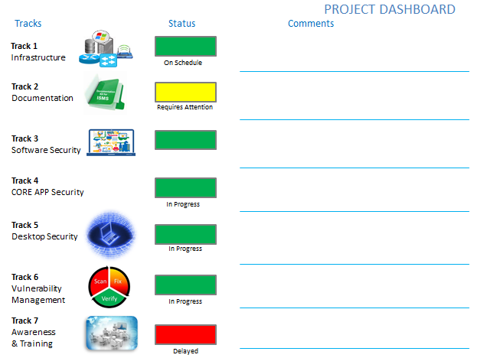
PROJECT MANAGEMENT FOR INFOSEC: PART 3

Slide 7
PROJECT MANAGEMENT FOR INFOSEC: PART 3
Dashboard Objectives:
Provide simple & single view of all project tracks, and where the project stands
Highlight problem areas for management intervention and support
Monthly Steering Committee & Quarterly Board reports

Slide 8
PROJECT MANAGEMENT FOR INFOSEC: PART 3
Forum | Frequency | Report Format | Objectives
ISMC | WEEKLY | PDF MINS OF MEETING | IDENTIFY TASKS, RESPONSIBILITY, TIMELINE
STEERING COMMITTEE | MONTHLY | PPT PRESENTATION | INFORM RELEVANT HEADS OF PROGRESS, IDENTIFY CHALLENGES
BOARD MEETING | QUARTERLY | PPT PRESENTATION | CRITICAL LOOK AT PROGRESS ACHIEVED, IDENTIFY CHALLENGES & SOLUTIONS, SEEK ASSISTANCE

Slide 9
PROJECT MANAGEMENT FOR INFOSEC: PART 3
By creating an accurate, honest, and disciplined reporting mechanism, the project manager ensures that all project stakeholders are informed, involved and helping where necessary for project success
END

